Slide 1
CORS – Cross-Origin Resource Sharing & Web Security
System Design Fundamentals - Web Concepts

Slide 2
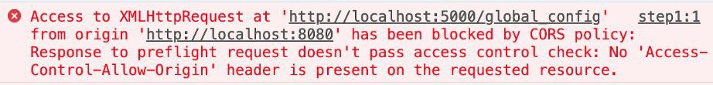
Why CORS Matters? (The Problem & Solution)
The Problem: Browsers enforce Same-Origin Policy (SOP), blocking cross-origin requests by default.
The Need for CORS:
  Modern web apps rely on APIs hosted on diﬀerent domains (e.g., Frontend on app.com, API on api.com).
  CORS is a mechanism that allows secure cross-origin communication.

Slide 3
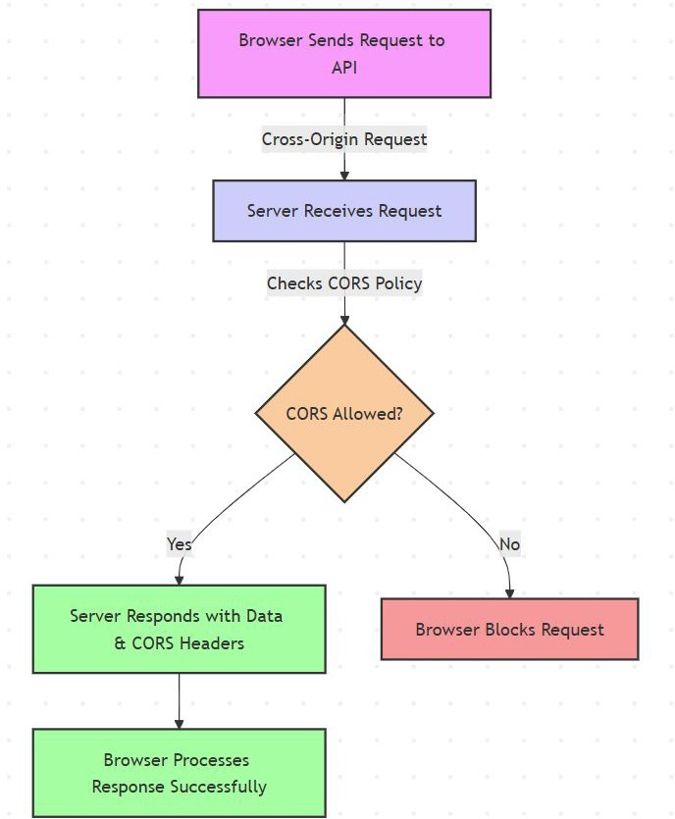
How CORS Works: Requests & Responses
CORS is server-driven – the server must explicitly allow access.
Two types of requests:
  Simple requests: GET, POST (without custom headers).
  Preﬂight requests: Needed for PUT, DELETE, or custom headers.
CORS Headers control:
  Access-Control-Allow-Origin (which origins can access).
  Access-Control-Allow-Methods (allowed HTTP methods).
  Access-Control-Allow-Headers (custom headers that can be sent).

Slide 4
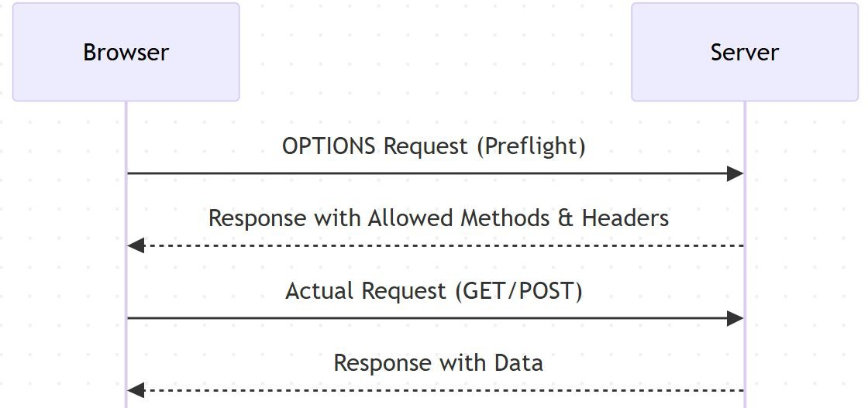
Preﬂight Requests & CORS Headers
Some requests require preﬂight checks (sent via OPTIONS request).
Browser ﬁrst sends a preﬂight request before making the actual request.
If the server responds with valid CORS headers, the browser allows the actual request.
Key Headers:
  Access-Control-Allow-Origin: https://example.com
  Access-Control-Allow-Methods: GET, POST
  Access-Control-Allow-Headers: Authorization, Content-Type

Slide 5
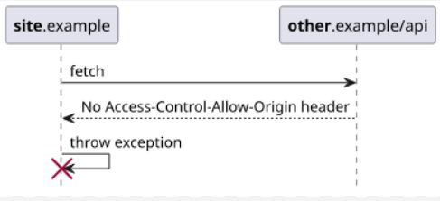
Security Risks & Common Misconﬁgurations
Common security risks:
  Overly permissive CORS
(Access-Control-Allow-Origin: *) → Allows any website to access sensitive data.
  Allowing credentials with *
(Access-Control-Allow-Credentials: true with * origin) → Leads to security vulnerabilities.
  Exposing sensitive APIs via improper CORS settings.
Mitigation Strategies:
  Use a whitelist of trusted origins instead of *.
  Set correct CORS policies for diﬀerent API endpoints.
  Use Reverse Proxies or API Gateways to handle
CORS securely.

Slide 6
Handling CORS in APIs (REST & GraphQL)
CORS in REST APIs:
  JSON-based APIs commonly use CORS.
  Conﬁgure headers properly in backend frameworks (e.g., Express.js, Spring Boot, Django).
CORS in GraphQL APIs:
  GraphQL APIs also need CORS handling since they operate over HTTP.
  Preﬂight requests occur due to complex queries & mutations.

Slide 7

Alternatives to CORS & Role of API Gateways
Alternatives to CORS for Cross-Origin Requests
  Reverse Proxy:
    Forwards client requests to the backend, bypassing browser CORS restrictions.
    Example: Nginx proxying requests to a backend API.
  API Gateway Handling CORS:
    Centralized control of CORS policies for multiple services.
    Example: AWS API Gateway conﬁguring allowed origins.
How API Gateways & Reverse Proxies Help?
  Reverse Proxies handle cross-origin requests internally to avoid CORS issues.
  API Gateways enforce CORS policies centrally, ensuring security & consistency.
  Both improve performance by reducing unnecessary browser preﬂight requests.

Slide 8
Interview Questions on CORS & Web Security
What is the Same-Origin Policy, and why does it exist?
How does CORS enable cross-origin requests?
What is a preﬂight request, and when is it required?
How do you conﬁgure CORS headers on a server?
What are common security risks associated with CORS?
What are alternatives to CORS for handling cross-origin requests?
How do API Gateways and Reverse Proxies help with CORS?

Slide 9
Summary & Key Takeaways
Same-Origin Policy (SOP) restricts cross-origin requests for security reasons.
CORS is a server-side mechanism that allows controlled cross-origin access.
Properly conﬁgured CORS prevents security risks.
Alternatives like backend proxying can bypass CORS when needed.
What’s next:
  Moving to Summary & Practical Applications of Web Concepts.

Slide 10
Section Summary - Web Concepts in System Design
Introduction to Web Concepts
  How web applications work (Client-Server Model, Request-Response Cycle)
  Stateless vs. Stateful interactions
  Importance of security, scalability & performance
Web Sessions: Managing State
  Cookies, Server-Side Sessions, JWTs, Token-Based Authentication
  Security concerns (Session Hijacking, CSRF)
  Best practices for scaling session management
Serialization: Data Exchange & Storage
  Formats: JSON, XML, Protocol Buﬀers,
  Trade-oﬀs: Readability, Eﬃciency, Compatibility
  Serialization in APIs, caching, and databases
CORS & Web Security
  Same-Origin Policy & why CORS is needed
  How CORS works (Preﬂight Requests, Allowed Headers & Methods)
  Common misconﬁgurations & security risks
  API Gateways & Reverse Proxies for CORS handling
What’s next:
  Scalability in System Design

